Slide 1
Science for the Public
Drew McCullough
Mentor: Tom Beal/Sarah Garrecht Gassen
Arizona Daily Star
23rd Annual Arizona Space Grant Consortium Symposium
University of Arizona April 12, 2014
Notes:
Hello, my name is Drew McCullough and today I am going to talk about the relationship between science and science journalism and how that affects the public.

Slide 2
What is the issue?
Important and beneficial science always happening
General public does not always learn about it
Notes:
One continuing issue in the world of science is that important and beneficial science is always happening, but the general public does not always learn about it.

Slide 3
How do we solve it?
Science journalism
Communication of science information becomes:
More available
Easy to understand
Notes:
When science meets journalism, however, the communication of science information to the general public becomes more available and easy to understand.

Slide 4
The main goal
Convey scientific stories in a way that a general audience can easily understand
Notes:
The main goal of science journalists is to: convey scientific stories in a way that a general audience can easily understand.

Slide 5
What tools do we have?
Science journalists use:
Research techniques
Interview skills
Writing
Notes:
In order to complete this goal, science journalists have many different tools. For example, science journalists use research techniques to find important stories to relay to the public; interview skills to collect information; and writing to convey the story in a way that a general audience can understand.

Slide 6
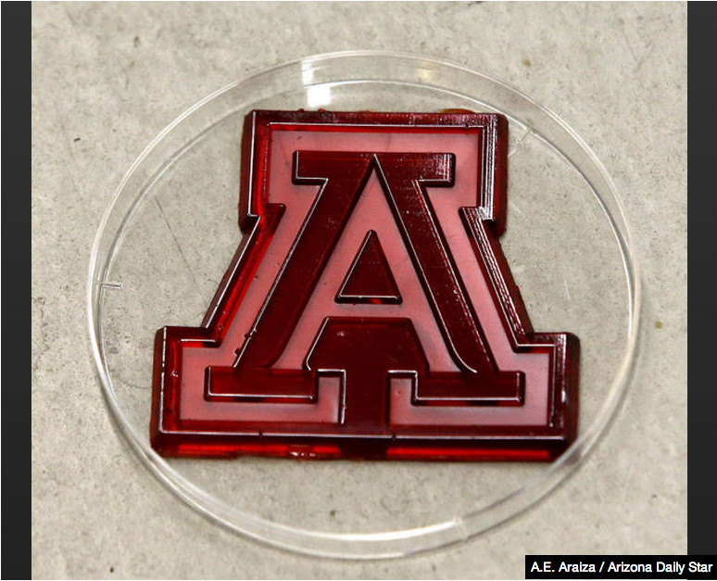
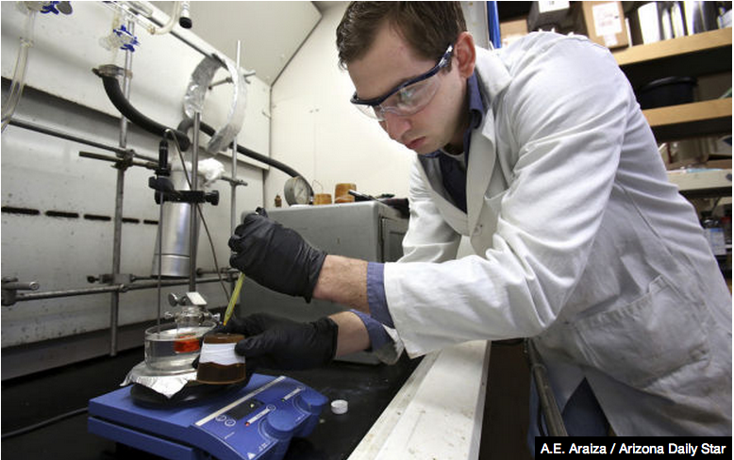
Important science stories
UA Professor Jeff Pyun
Research team discovered a way to turn waste sulfur into plastic
An example of
plastic made out of waste sulfur.
Jared Griebel, a member of Pyun’s research team, turns waste sulfur into plastic.
Notes:
Important story examples include a story about a University of Arizona Professor named Jeff Pyun, who leads a research team. The research team discovered a way to turn waste sulfur into plastic. This is helpful because there is so much waste sulfur in the world, but there is currently no effective way to begin to get rid of all of it. Pyun’s team, however, has made progress in the fight against waste sulfur, and hopefully will contribute to solving the problem of getting rid of the waste sulfur.

Slide 7
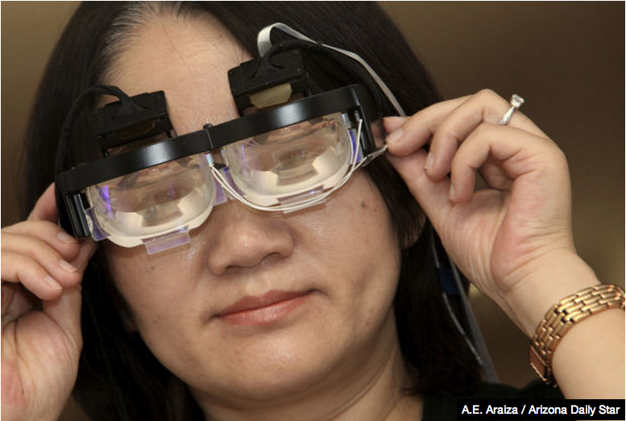
Important science stories
UA Professor Hong Hua
Developing a variety of wearable head-mounted display systems
Professor Hong Hua wearing one of her head-mounted displays.
Notes:
Another important story is a story about a University of Arizona Professor named Hong Hua, who is developing a variety of wearable head-mounted display systems. Hua’s systems will have a number of different applications, such as medical, military and entertainment.

Slide 8
Important science stories
UA Undergraduate Biology Research Program
Notes:
Another important story is a story about the University of Arizona Undergraduate Biology Research Program. The UBRP is designed to give undergraduate students hands-on experience working in a research laboratory with a UA faculty member.

Slide 9
Why is this important?
Positively impact the general public
Inform it of science work that has the potential to benefit the world
Notes:
So why is all of this important? Well, the science-related stories that I have written throughout the last six months positively impact the general public by informing it of science work that has the potential to benefit the world.

Slide 10
Thank you.
Questions?
Notes:
Thank you. Are there any questions?

